Slide 1
Picture of Health in Sheffield
September 2024

Slide 2
Health inequalities
“Health inequalities are unfair and avoidable differences in health across the population, and between different groups within society. These include how long people are likely to live, the health conditions they may experience and the care that is available to them.”
- NHS England
Sheffield Health and Wellbeing Board

Slide 3
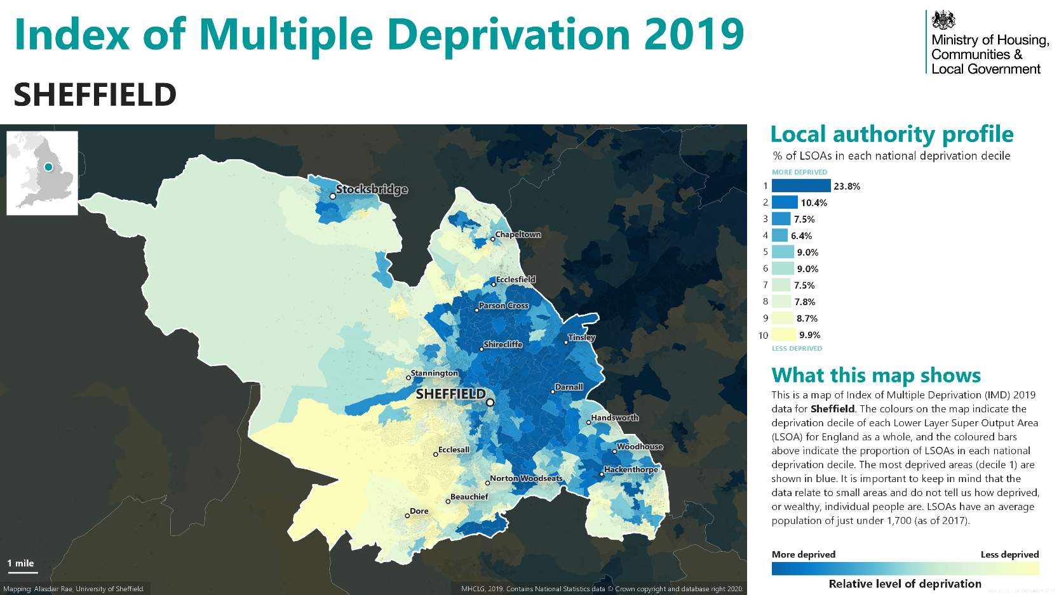
3
Sheffield Health and Wellbeing Board

Slide 4
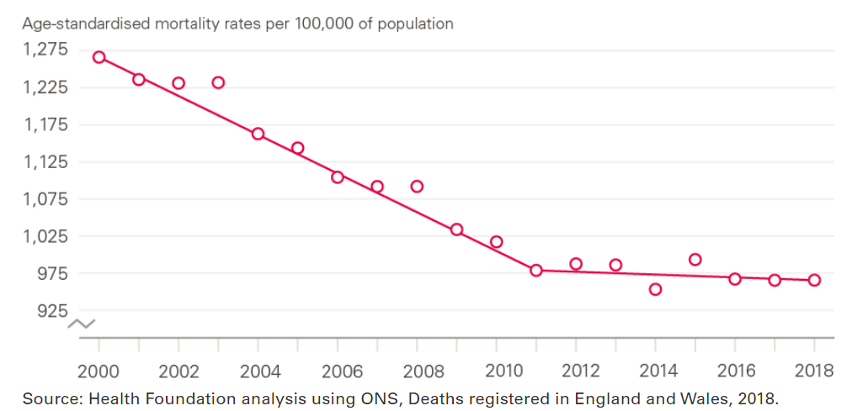
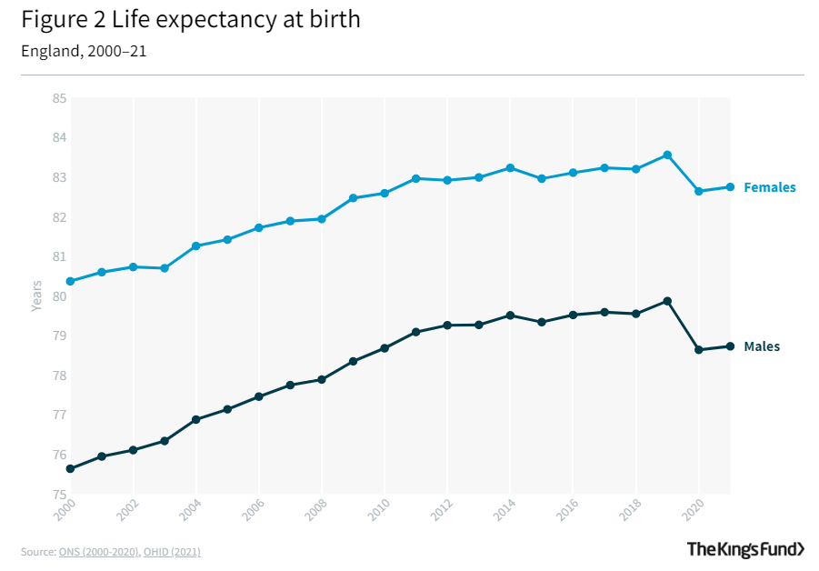
Life expectancy and healthy life expectancy
Nationally, the slowing of life expectancy gains is flatter in less deprived areas, and those historic gains are stalling or reversing in the most deprived
areas where life expectancy by comparison is already shorter.
This means inequalities are widening nationally, and Sheffield is no exception to this trend.
Why is life expectancy falling?
No single factor can be isolated. Some health gains (lipids, tobacco control) have come close to maxing out their benefits. Undeniably, austerity policies
have played a role by negatively impacting the critical services that underpin prevention of poor health and improvement of life chances. Longer term
term factors are also at play, including failures in housing, employment, economic, social and health policy decisions which have embedded and sometimes
worsened inequalities.
4
Sheffield Health and Wellbeing Board

Slide 5
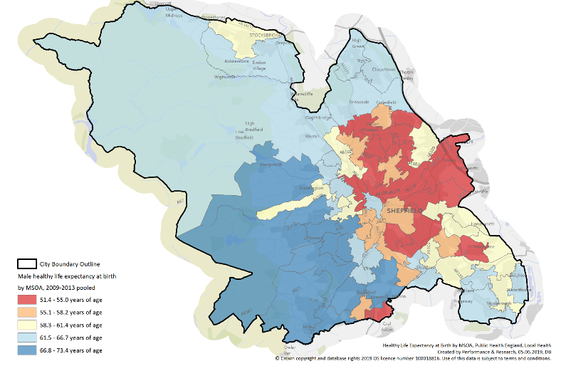
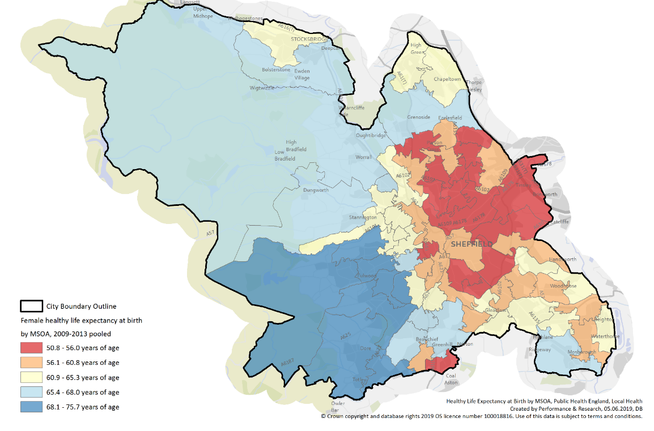
Healthy life expectancy at birth
Women
Men
Healthy life expectancy refers to the average number of years a person can expect to live in good health, without experiencing significant illness or disability.
It is a measure that considers both longevity and the quality of life by accounting for the years spent in good health rather than simply overall lifespan. In Sheffield, women can expect to live to 82, with 18 years lived in poor health. For men, it’s 79 years with 16 years in poor health.
Why this matters – HLE is a defined by many different influences – ultimate strategic goal is to narrow the gap, but many different outcomes contribute to HLE. Improving HLE is an indicator that other factors of health and wellbeing are improving in general. It matters to both the NHS & social care (poor HLE drives demand largely from preventable non-communicable illness with earlier onset in some populations) and the economy (lost productivity on account of poor health at earlier ages).
5
Sheffield Health and Wellbeing Board

Slide 6
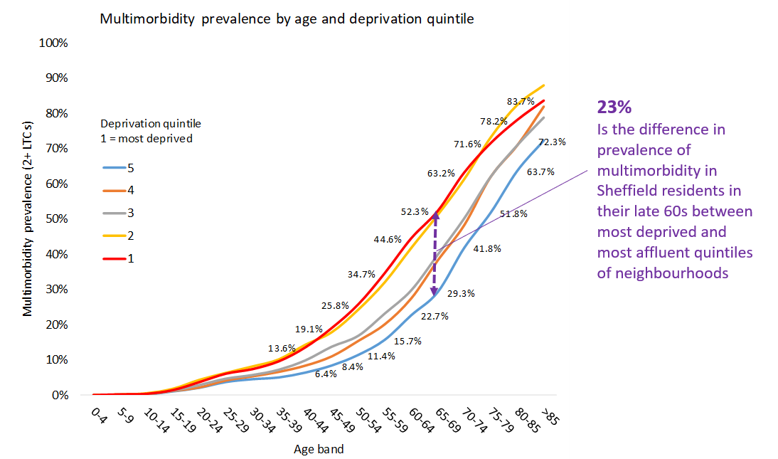
Multimorbidity
A significant symptom and driver of health inequality is multimorbidity. This was first well documented in Scotland (Barnett on multi morbidity in Scotland. Lancet 2012) but similar work has been done in many places in England over recent years (Somerset, Sheffield, Bradford) and the story is broadly the same.
The key metric is a 10-15 yr difference in onset of MM between most and least deprived areas. Or at any given age 15% difference in prevalence of MM across that spectrum of inequality.
This is where NHS and social care demand comes from. It is the largest single shift in epidemiology in the last 3 decades. Ever more efficient systems to address demand will not address this problem.
Multi morbidity and frailty are not inevitable. They are largely preventable.
From the Lancet Commission paper on health need: “Meeting the challenges of the future will require an increased focus on health promotion & disease prevention, involving a more concerted effort to tackle the multiple social, environmental, and economic factors that lie at the heart of health inequalities” – and are driving the increase in MM and declining HLE.
6
Sheffield Health and Wellbeing Board

Slide 7
1. Tackle Racism, Discrimination and their outcomes
We must take action to improve data collection and intelligence about inequalities symptomatic of racism and discrimination. This involves several strategic actions:
Comprehensive Demographic Data Collection Across all Sectors:
Implement standardized and inclusive data collection practices across all public services to gather detailed demographic information, including ethnicity, socioeconomic status, and other relevant factors.
Community Engagement and Trust Building:
Engage with marginalized communities to build trust and encourage participation in data collection efforts. Ensure that data collection processes are culturally sensitive and that communities understand the importance and benefits of providing their information. Make communities active stakeholders in the intelligence and analysis gained from this participatory work.
Interdisciplinary Research and Collaboration:
Foster collaboration between healthcare providers, researchers, and social scientists to integrate diverse perspectives and methodologies in studying health inequalities. This approach can move us towards a more holistic understanding of the factors driving disparities.
Use of Advanced Analytics and Technology:
Employ advanced Public Health Intelligence and Business Intelligence analytics to identify patterns and trends in relevant data in novel, innovative ways to uncover hidden disparities and provide insights into the underlying causes.
Policy Advocacy and Implementation:
Advocate for and implement policies that encourage the collection and reporting of health inequality data. Ensure that findings are used to inform local government strategies and interventions aimed at reducing disparities and addressing systemic racism and discrimination.
7
Sheffield Health and Wellbeing Board

Slide 8
2. Give Every Child the Best Start in Life
Key Priorities:
Poverty. In Tinsley and Carbrook 53% of children live in absolute low-income households. This is compared to just 2.5% in Endcliffe and Ranmoor. “Being poor is associated with so many childhood adversities that it may be considered an Adverse Childhood Experience (ACE) itself, more pervasive and persistent than all others. As children’s economic circumstances are inextricably tied to those of their families, promoting family financial health by mitigating poverty as an ACE is critical to expanding opportunities for every child”.¹
Oral Health. 30.8% of five-year-olds in Sheffield have experience of visibly obvious dental decay. Tooth extraction is the most common procedure requiring general anaesthesia in children aged 6-10yrs old. Almost 9 out of 10 hospital tooth extractions among children aged 0 to 5 years are due to preventable tooth decay, and tooth extraction is still the most common hospital procedure in 6 to 10 year olds (OHID, 2022), leading to missed education, and time off work for parents/carers. Sheffield experiences some of the highest levels of hospital extractions seen nationally. Sheffield has higher levels of tooth decay than other South Yorkshire LA areas, Y&tH and England. Tooth decay was significantly higher amongst the more deprived and non-white ethnic groups according to a 2023 report
Adverse Childhood Experience and Trauma. ACEs are linked to a wide range of long-term health problems, including increased risk of chronic diseases, mental health issues, and substance abuse, and can affect long-term life chances. Children who experience ACEs can have reduced educational attainment, and ACEs have a compound effect whereby those children who experience multiple ACEs are at much higher risk of poor outcomes. ACEs are closely linked with poverty and deprivation.
8
Sheffield Health and Wellbeing Board

Slide 9
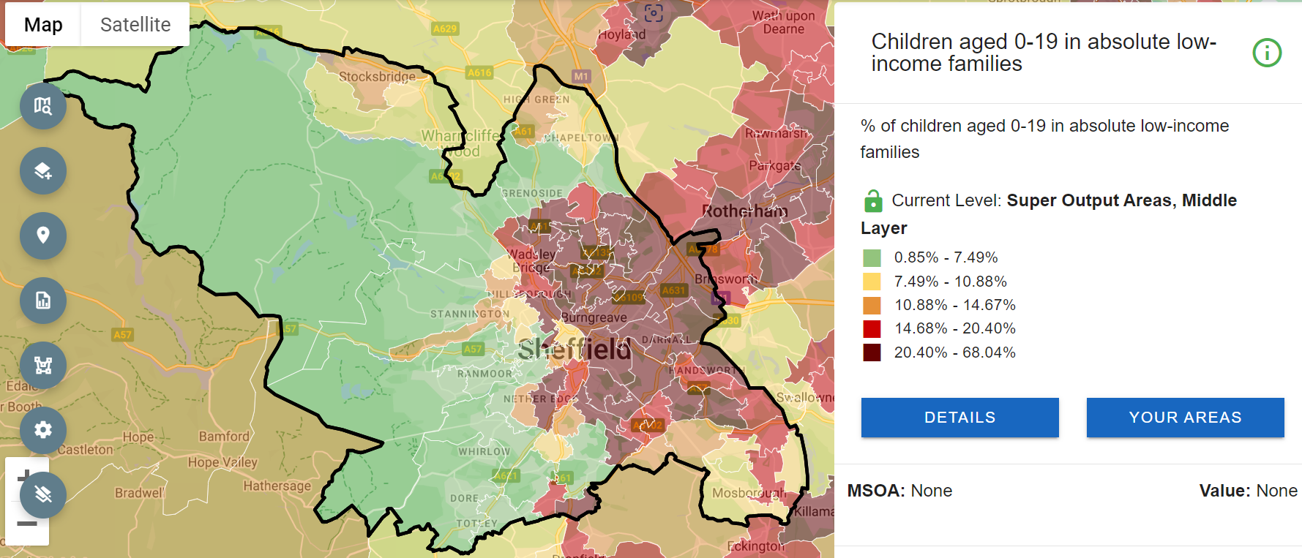
In Tinsley and Carbrook 53% of children live in absolute low-income households. This is compared to just 2.5% in Endcliffe and Ranmoor. “Being poor is associated with so many childhood adversities that it may be considered an Adverse Childhood Experience (ACE) itself, more pervasive and persistent than all others. As children’s economic circumstances are inextricably tied to those of their families, promoting family financial health by mitigating poverty as an ACE is critical to expanding opportunities for every child”.¹
2. Give Every Child the Best Start in Life
9
Sheffield Health and Wellbeing Board

Slide 10
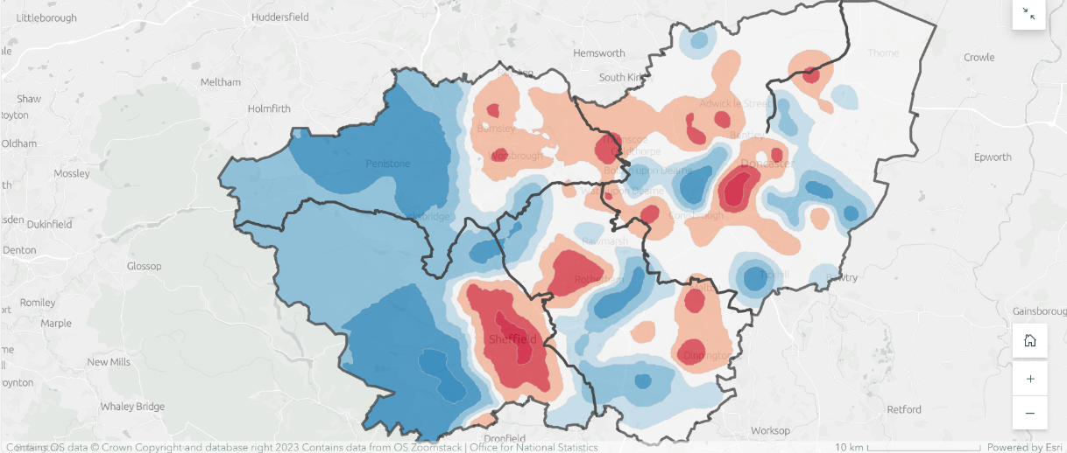
2. Give Every Child the Best Start in Life
Predictive modelling by Sheffield Hallam University shows the likely distribution of trauma exposure across South Yorkshire, with red areas indicating trauma hotspots, and blue areas indicating trauma coldspots. Lighter shades and clear areas indicate close to average trauma exposure levels.
“There are two very different experiences of growing up in South Yorkshire. In one extreme, children have much less potential exposure to Adverse Childhood Experiences. There are low overall crime rates; violence and sexual offending is rare; health outcomes, incomes, and employment rates are well above average. For those children unlucky enough to have been exposed Adverse Childhood Experiences in these areas, the adults in their lives are more likely to be able to support them, there are also well-equipped schools with workforces that have the skills and confidence to identify and, where appropriate, respond.
There are areas in South Yorkshire, however, where none of this is true. Exposure to crime is high, violence and sexual offending is insidious, opportunities are low, poverty is high and, in many cases, schools may not be equipped well enough to identify their needs and respond.”
Identifying Trauma Hotspots in Sheffield (arcgis.com)
10
Sheffield Health and Wellbeing Board

Slide 11
3. Enable all children, young people and adults to maximise their capabilities and have control over their lives
Lifelong education, skills and training matters:
Enhanced Employment Opportunities: Education and vocational training increase access to a broader range of employment opportunities, equipping individuals with the skills needed to adapt to a rapidly changing job market, thus ensuring long-term career stability and income growth.
Empowerment Through Knowledge: Education fosters critical thinking, problem-solving, and decision-making skills, enabling individuals to make informed choices regarding their health, finances, and personal development, thereby gaining more control over their life trajectory.
Reduction of Social Inequalities: Access to quality education for all, regardless of background, helps to level the playing field, reducing socioeconomic disparities and promoting upward mobility, which allows individuals to break free from poverty and marginalization.
Improved Health and Well-being: Educated individuals are more likely to engage in healthier behaviors and make better lifestyle choices. This knowledge contributes to improved mental, emotional, and physical health, enhancing overall life satisfaction and control.
Active Civic Engagement: Education promotes civic responsibility and social awareness, encouraging individuals to participate actively in their communities and engage in democratic processes. This leads to a stronger voice in shaping policies that impact their lives and future.
11
Sheffield Health and Wellbeing Board

Slide 12
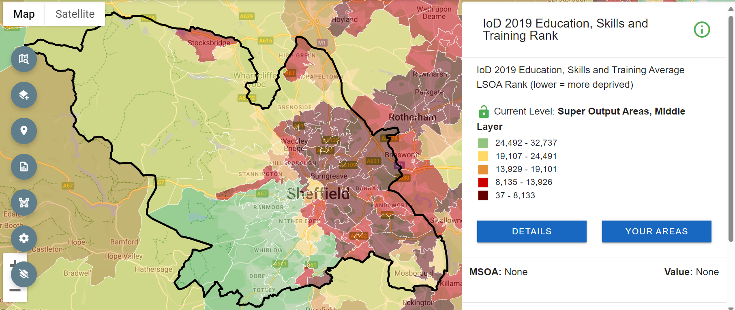
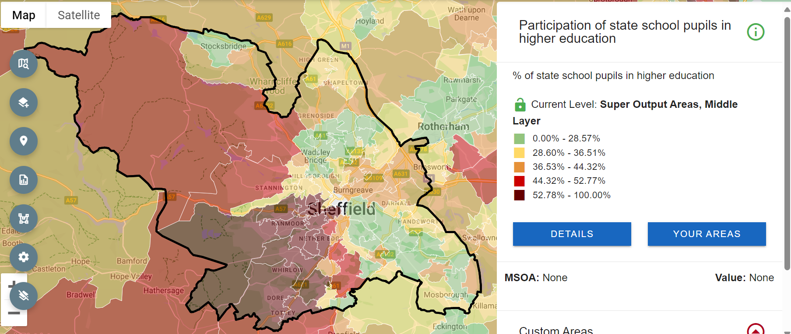
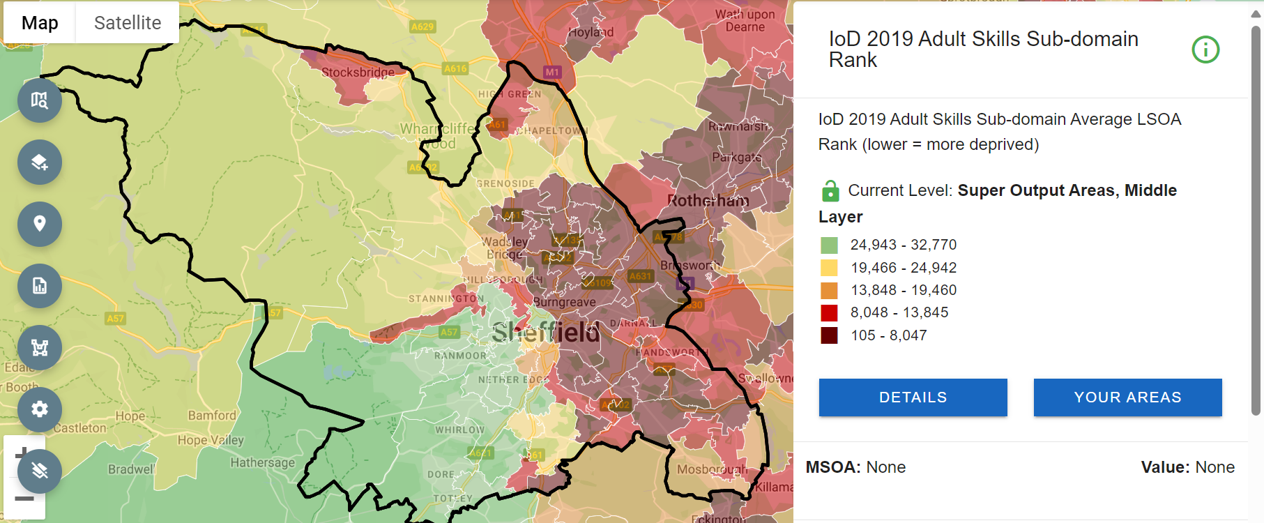
3. Enable all children, young people and adults to maximise their capabilities and have control over their lives
12
Sheffield Health and Wellbeing Board

Slide 13
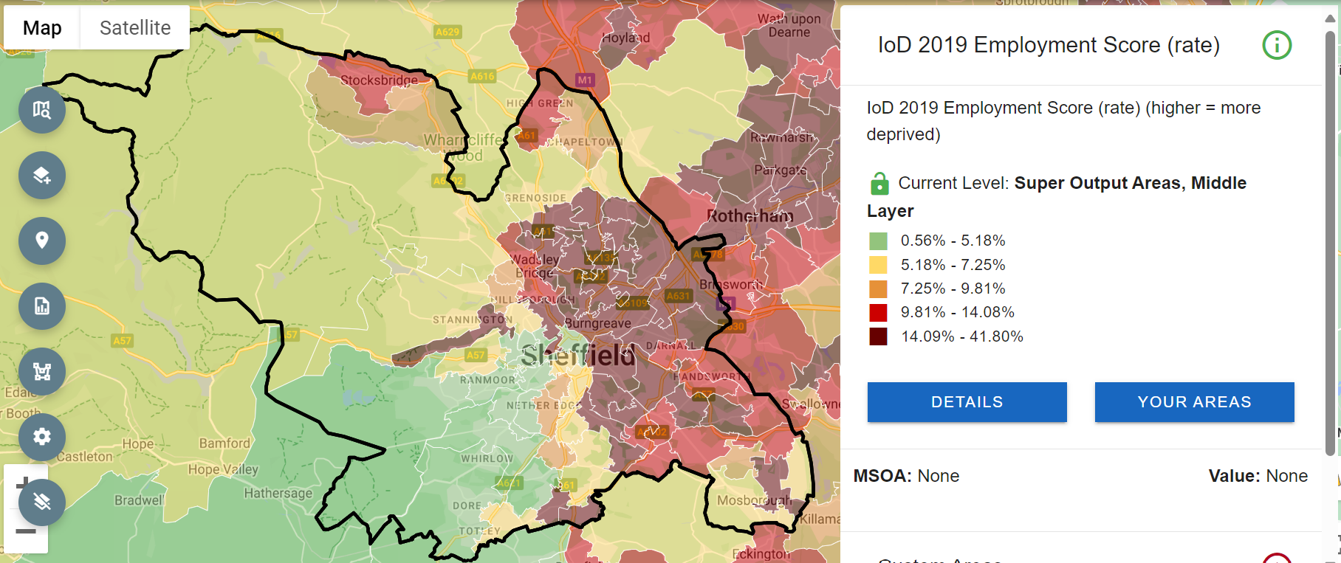
The Indices of Deprivation (IoD) 2019 Employment Deprivation Domain measures the proportion of the working age population in an area involuntarily excluded from the labour market. This includes people who would like to work but are unable to do so due to unemployment sickness or disability or caring responsibilities. In Sheffield, there is considerable inequality in this exclusion. In Firth Park, more than 1 in 4 people are excluded from the labour market, whilst in Dore and Whirlow fewer than 1 in 20 people experience this.
3. Create fair employment and good work for all
13
Sheffield Health and Wellbeing Board

Slide 14
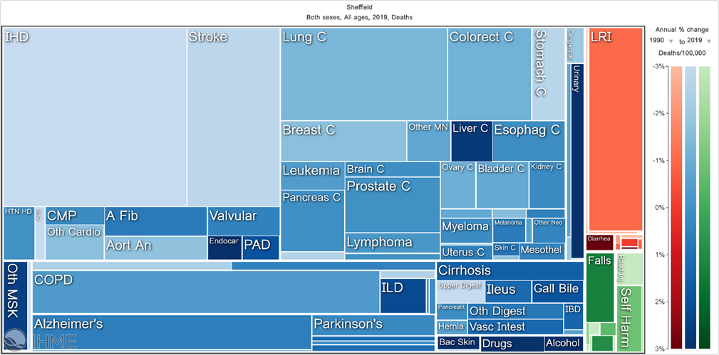
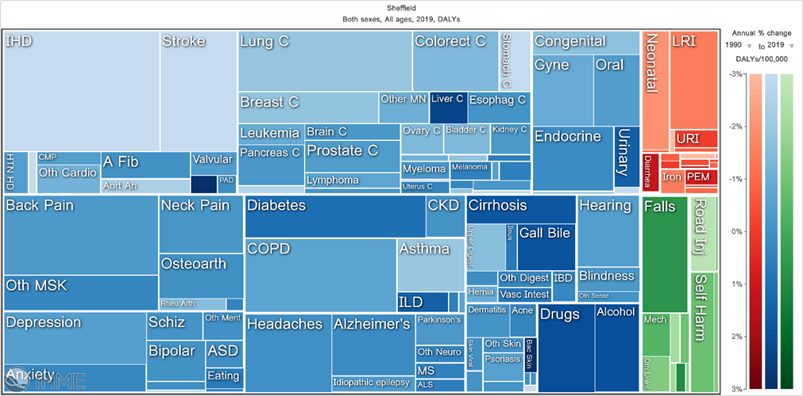
The tree maps shown above are essentially square pie charts, with the size of individual squares representing the major causes of death (left) and morbidity (right) which have remained broadly constant since 1990, with significant progress made on smoking, diet and lipid modification as well as some advances in diagnosis meaning that CVD and some cancers have seen a drop in rates for both mortality and morbidity. Worsening trends for Sheffield are shown in darker shades, and are consistent with the findings of the Lancet Commission which explored the changing health needs of the UK population.
The data shown in the tree maps emphasises that ill health and its main drivers are amenable to prevention and intervention. There is a temptation to view this data and reduce the risk factors and the burden of ill health to a simplistic and false narrative about poor individual choice and a lack of ‘personal responsibility’ for health. Commercial actors and media outlets sympathetic to this narrative encourage policy to be shaped around the individual and education to make ‘informed decisions’ about commodities that are addictive, harmful, and heavily promoted. This detracts from investment in upstream interventions which have much greater benefit to population health (see Defining and conceptualising the commercial determinants of health - The Lancet 2023 for more detail). Of particular concern is the rising trend in Type 2 diabetes, which remains a substantial public health issue.
5. Ensure a healthy standard of living for all and 6. Create and develop healthy places and communities
14
Sheffield Health and Wellbeing Board

Slide 15
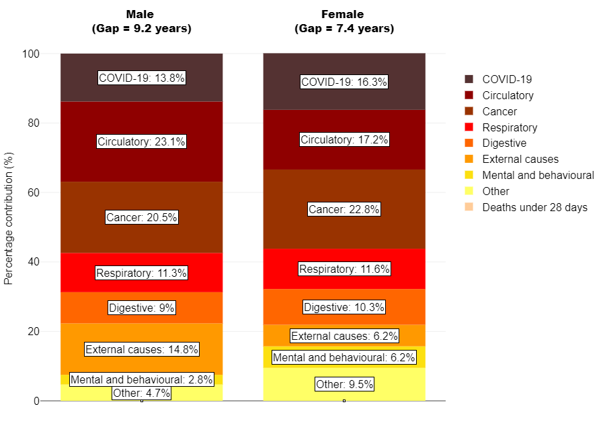
Breakdown of the life expectancy gap between the most and least deprived quintiles in Sheffield
5. Ensure a healthy standard of living for all and 6. Create and develop healthy places and communities
15
Sheffield Health and Wellbeing Board

Slide 16
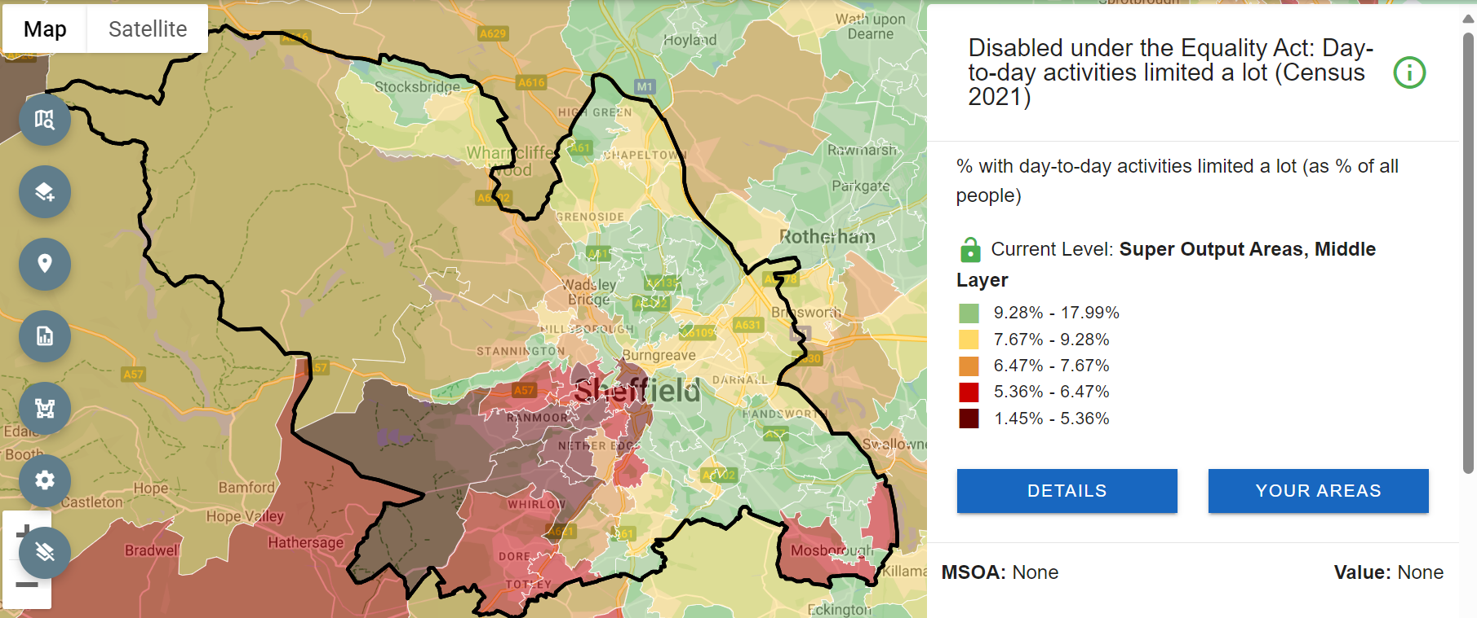
5. Ensure a healthy standard of living for all and 6. Create and develop healthy places and communities
16
Sheffield Health and Wellbeing Board

Slide 17
6. Create and develop healthy places and communities
Reduction in Health Inequalities: Healthy communities help to reduce disparities in health outcomes by ensuring equal access to safe, affordable housing, green spaces, healthy food, and healthcare services, which can significantly improve life expectancy and quality of life for all socioeconomic groups.
Promotion of Physical and Mental Well-being: Well-designed places encourage active lifestyles through walkable infrastructure, recreational facilities, and access to nature, while fostering social connections that enhance mental health and reduce feelings of isolation.
Prevention of Chronic Diseases: Healthy environments mitigate risk factors for chronic diseases such as obesity, diabetes, and heart disease by supporting healthy behaviors, including physical activity, nutritious diets, and reduced exposure to pollutants.
Resilience to Environmental and Social Challenges: Building healthier communities enhances their ability to respond to climate change, economic stress, and social challenges by creating adaptable infrastructure and encouraging sustainable practices that promote long-term community well-being.
17
Sheffield Health and Wellbeing Board

Slide 18
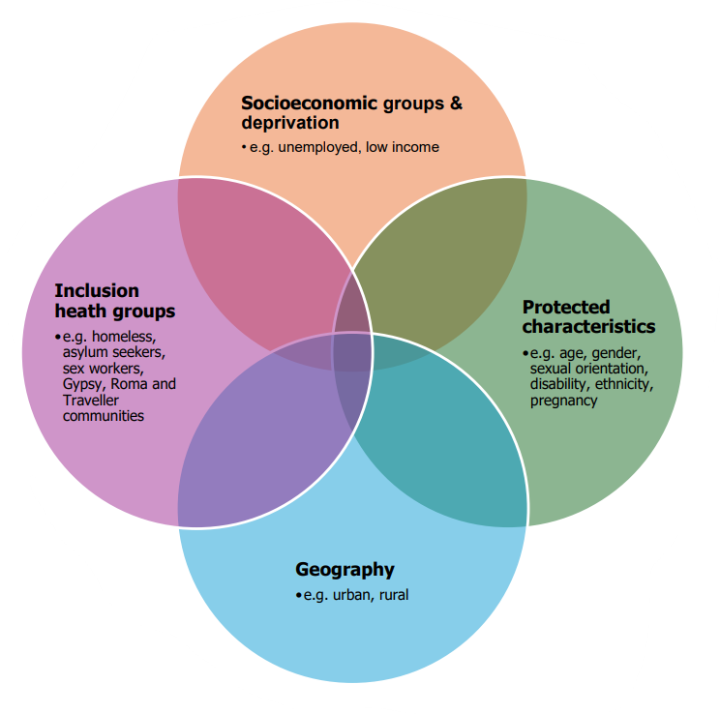
7. Ensure fair access to quality health and care services
There are overlapping ‘domains of inequalities’ that need to be recognised
• Addressing these goes beyond access to health services
• Wider determinants of health are essential as to the whole population are existing programmes considering the needs of IHGs
• When intersectionality is acknowledged, the significance of the role of the whole Place system becomes clear
What do we know about Inclusion Health Groups in Sheffield?
15% of people account for 50% of GP encounters
18% of prisoners released to Sheffield are without shelter on the night of their release
Roma, Gypsy and Traveller people have disproportionately high levels of DNAs in secondary care services
There are around 1000 victims of modern slavery in Sheffield (top 3 are Albania, Vietnam, and Nigeria)
There are around 3500 housebound people – many receive social care
700 new refugees arrive in Sheffield every year
86k people have experienced domestic abuse since the age of 16 in Sheffield
26k children are living in a family with domestic abuse
There is a 25-year mortality gap for people with severe mental illness
There is a 29-year mortality gap for people with a learning disability
Young male veterans (<25yrs) have two to three times the suicide risk of their civilian counterparts
18
Sheffield Health and Wellbeing Board

Slide 19
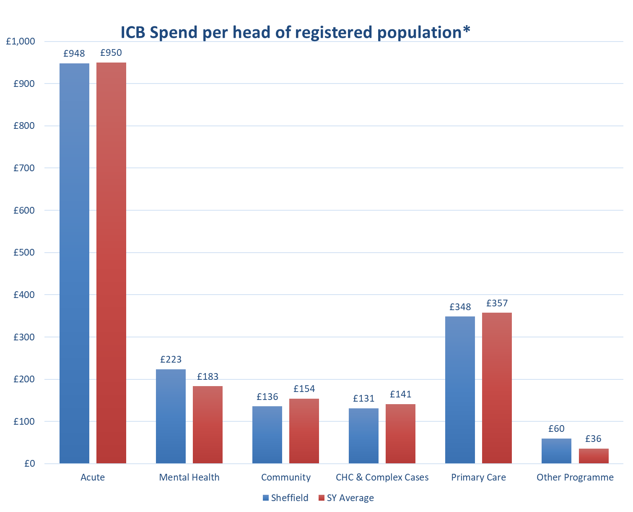
*weighted for age/sex/other demographic factors
7. Ensure fair access to quality health and care services
Address the allocative efficiency challenges of meeting acute care demand and rebalancing spend to support primary and community care
ICB Spend per head of registered population in Sheffield is £1,850 per annum, compared to £1,820 on average across South Yorkshire.
Sheffield spends 22% more on mental health, 12% less on community services, 7% less on CHC and 3% less on primary care compared to the SY average.
19
Sheffield Health and Wellbeing Board

Slide 20
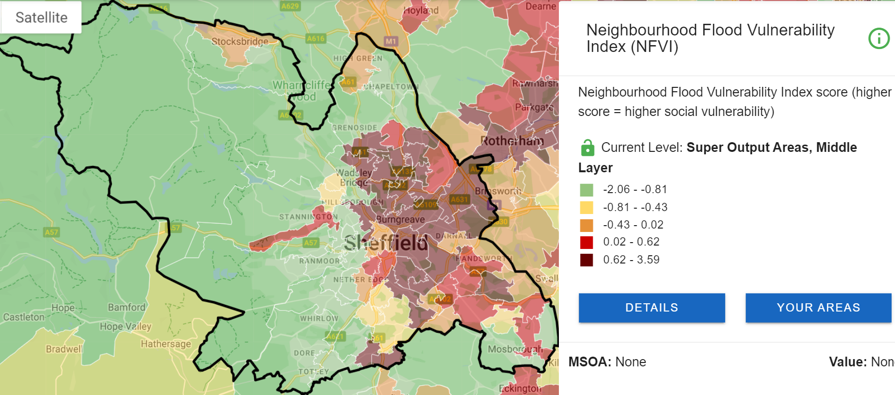
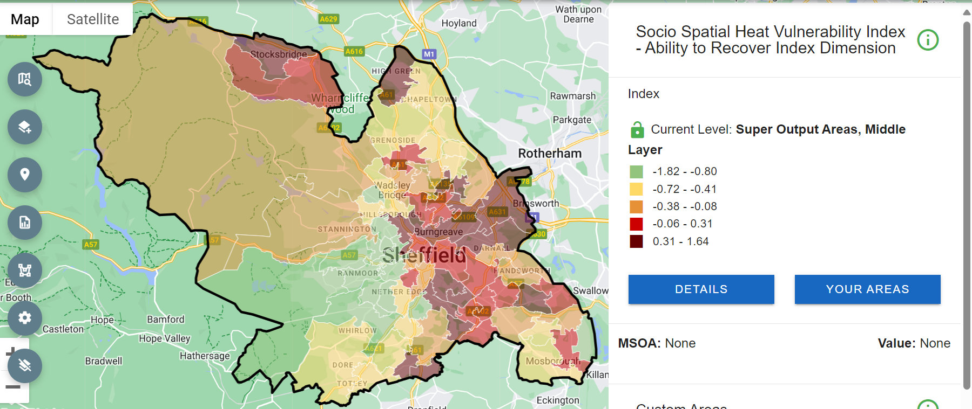
This means that inequalities felt now are likely to widen and be compounded by future climate related emergencies.
8. Pursue sustainability and fairer health together
Both flood risk, and a low level of resilience to heat stress from
climate change are concentrated in areas of greater deprivation
and poorer health.
*weighted for age/sex/other demographic factors
20
Sheffield Health and Wellbeing Board

